Slide 1
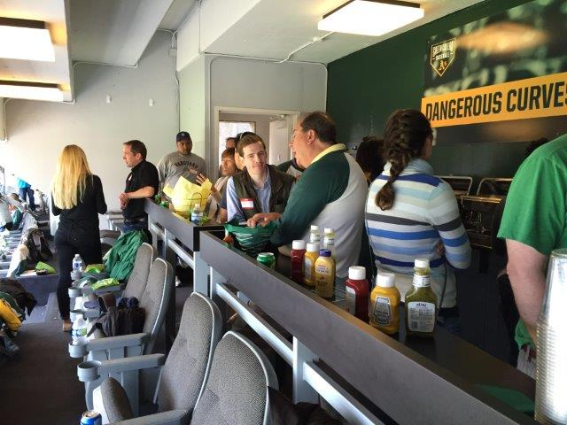
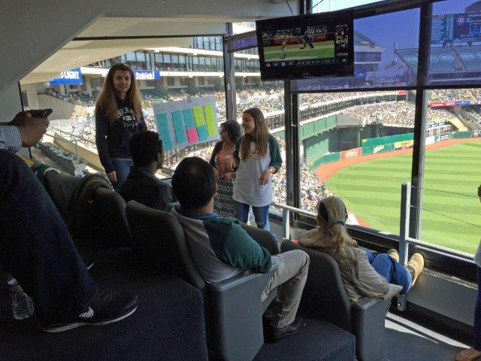
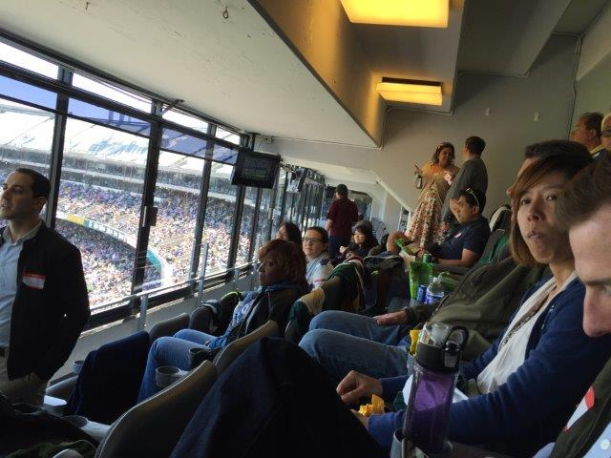
PMI SF Bay Area Chapter
8.19.2017
Annual General Meeting - 2017

Slide 2
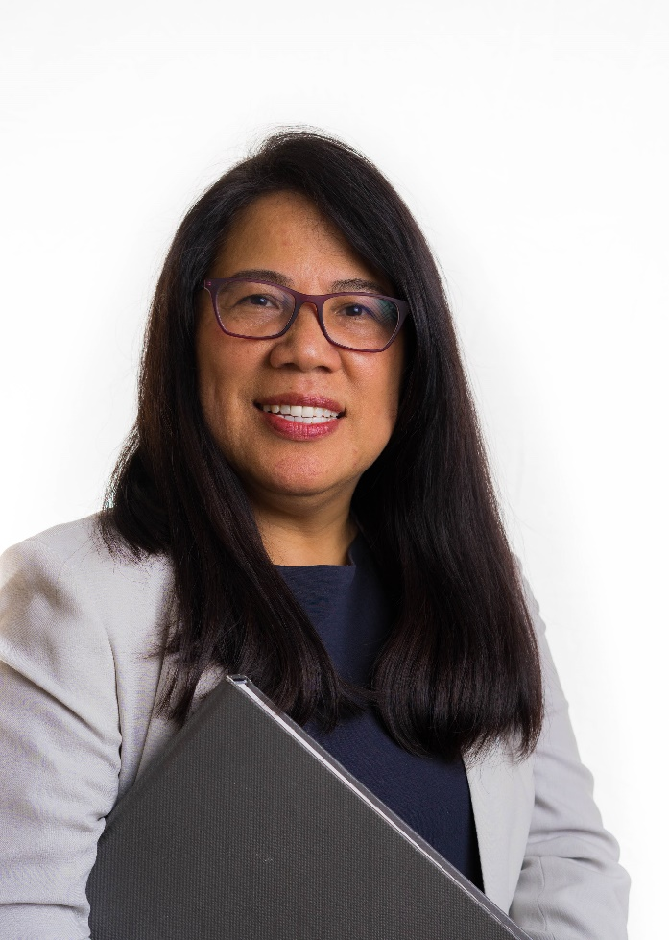
Review of Financial Performance
by
Zenaida Alejandrino PMP
Chief Financial Officer

Slide 3
Review of Financial Performance
Financial Activities Summary 2016

Slide 6
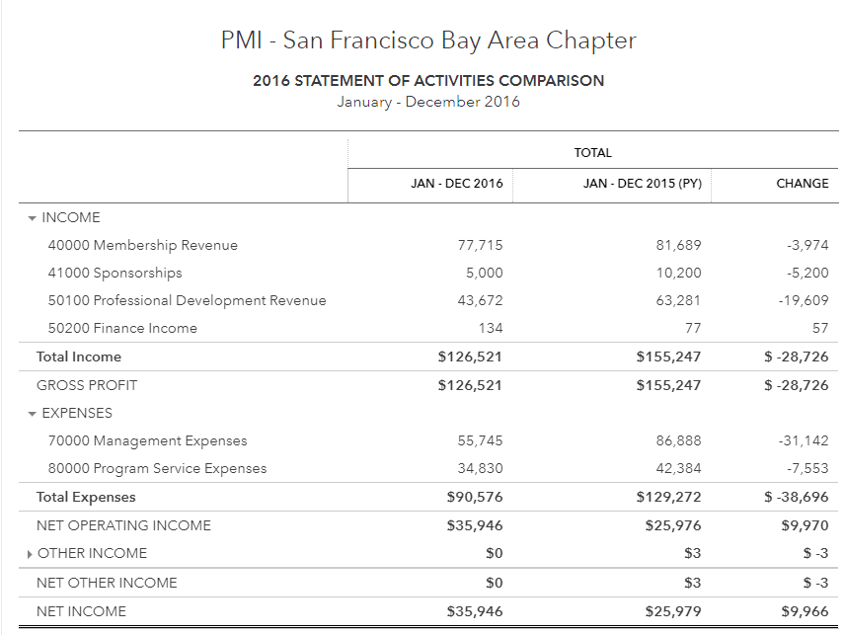
Review of Financial Performance

Slide 7
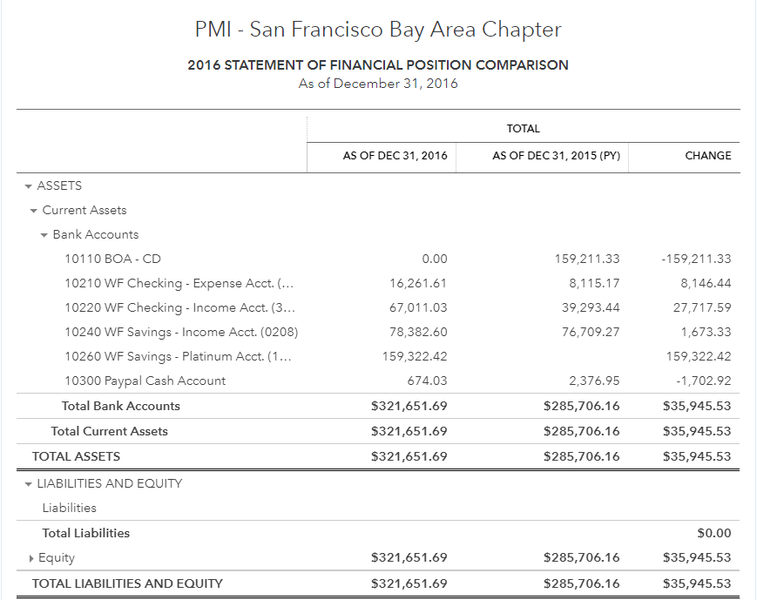
Review of Financial Performance

Slide 8
Review of Financial Performance
Cash Account Summary as of August 2, 2017
Wells Fargo Bank
First Republic Bank

Slide 9
Review of Financial Performance
Board Member at Large
Treasurer: Don Mcclure
Finance Team
Chief Financial Officer : Zenaida Alejandrino
Team Members:
Melissa Tong
Laura Narat
Magdalena Bryzek

Slide 10
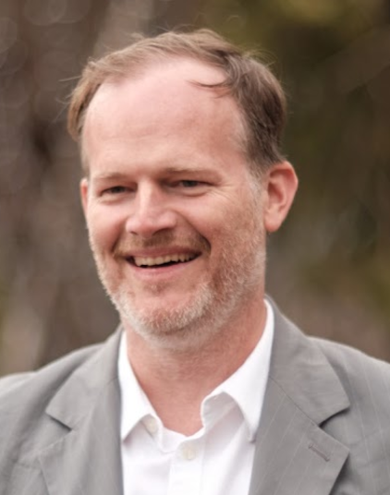
Chapter Performance and Updates
by
Nathan Mellin MBA, PMP, CSM, CSP, DTM, VFR
Board Director & acting Chief Executive Officer

Slide 11
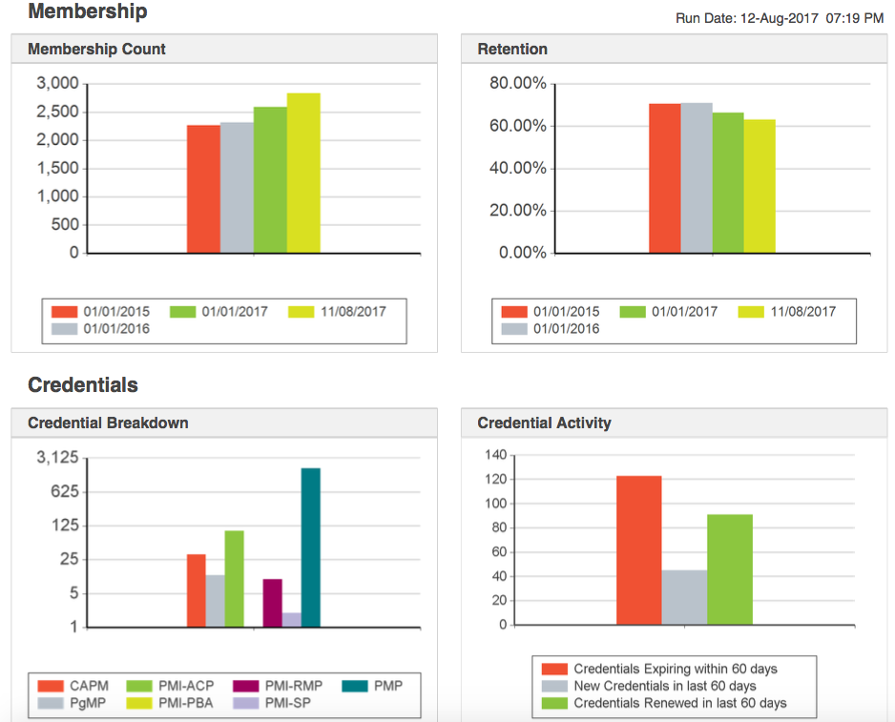
Chapter Membership Update

Slide 12
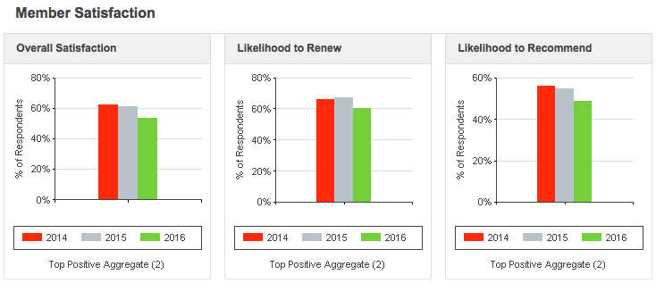
Chapter Membership Update

Slide 13
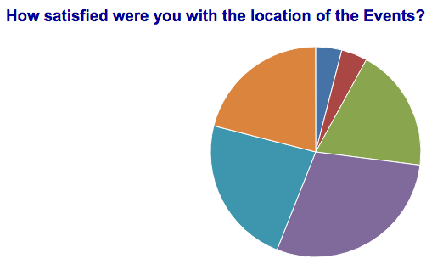
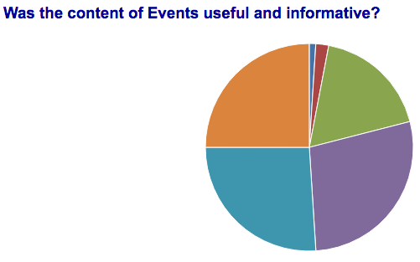
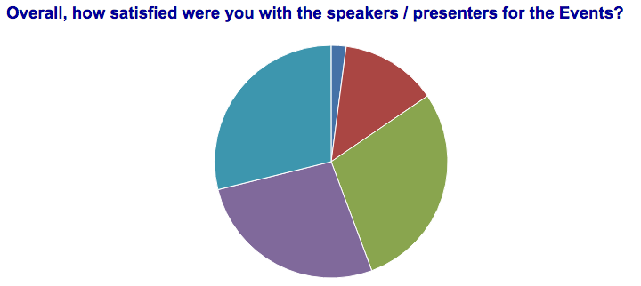
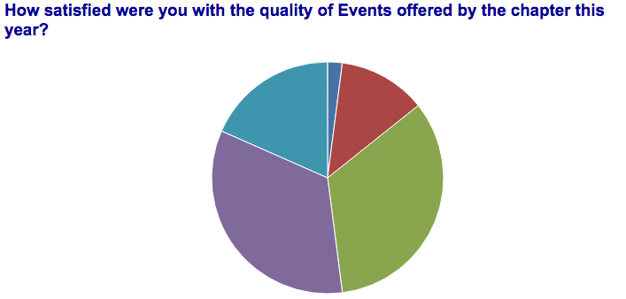
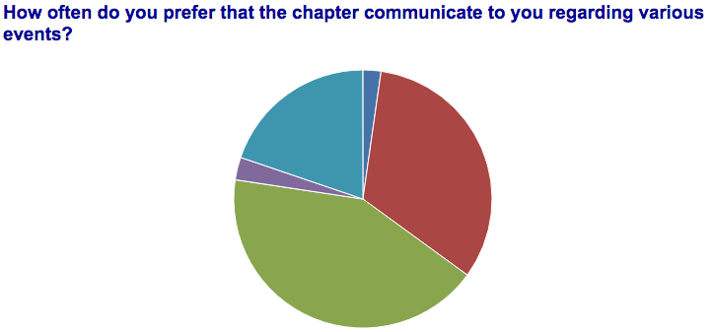
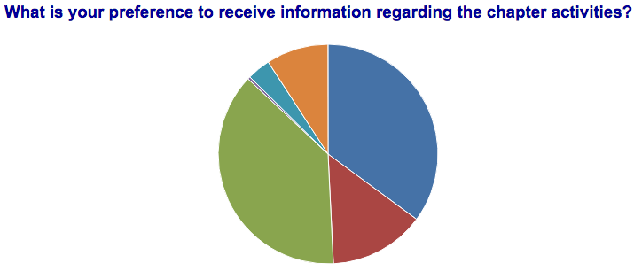
150 Survey Results – Member Appreciation 2017

Slide 14
PMISFBAC EVENTS by Attendance by Month 2017

Slide 15
PMISFBAC EVENTS by INCOME for 2017

Slide 16
Military Outreach Program
New Programs
Status update
New PMI SF Chapter Military Outreach Director
Working with other chapters to share knowledge and build up this community.
Create new positions “military mentors”
PMISFBAC outreach to Travis AFB and GGU/Devry veterans.
PMISFBAC to partner with Wells Fargo in September
PMI Global support for Military programs at LIM
PMI Tri-valley military outreach conference 2017

Slide 17
Academic Outreach Program
New Programs
Status update
Outreach to high school in Foster City, presented project management for 2 different occasions, huge success, look to repeat similar effort 2017
Career fairs & partnering with Bay area Universities: GGU, DeVry, HULT, SF State, UCSF, San Mateo CC, CCSF
Working with DeVry, GGU, SF state to leverage their facilities for PMI events to strengthen partnership.
Focus at career fairs is to provide opportunity to bring awareness to certification, project management resources, networking, and volunteer opportunities.

Slide 18
Chapter Numbers & Updates
Chapter updates
Membership History:
2014: 2,217 2016: 2,595
2015: 2,315 Current: 2,837
New Members last year – 1085 ↑ 704 in 2015
14% of the total region – NV, CA, NM, HI ↑ (region 7208)
Annual Attrition rate 33% ↓ - region at 34%
Satisfaction indicator 53% ↓ region 63%
Reinforcing social media usage for Marketing team
Star Chapter & G-suite projects complete
Cross training team members & document material
Creating an inventory of speakers & topics

Slide 19
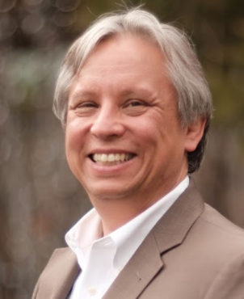
Looking Forward to 2018
by
Tyrone Navarro PMP
Tyrone.Navarro@pmisfbac.org
2017-2018 Board President
“Keeping the dialogue open between the Board and the Chapter’s Member-Owners (membership and other stakeholders) known as Ownership-Linkage under the Policy Governance® Model”

